Slide 1
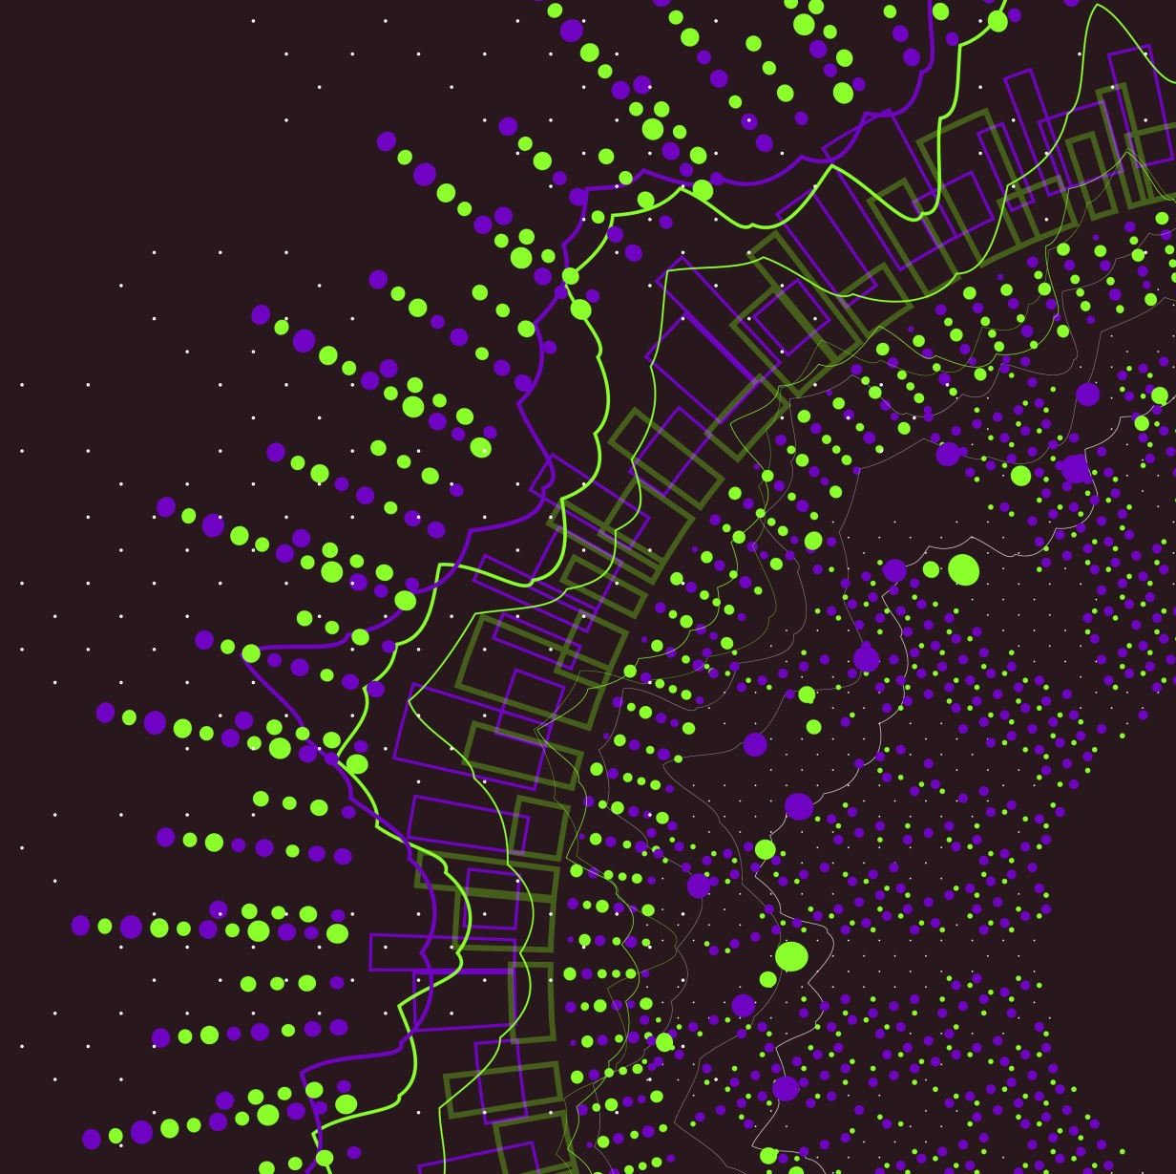
Deep Learning Approaches for Enhanced Classification of Ocular Diseases

Slide 2
Group Member Information
Rumana Shaik (700752115)
Sai Nikhil Aureshi (700756937)
Sanjana Mortha (700747286 )
Shiny Saka (700755150)

Slide 3

Role/Responsibilities and Contribution
Rumana Shaik
Developed the initial concept, designed the deep learning architecture, and authored the the research paper.
Sai Nikhil Aureshi
Managed the dataset, implemented convolutional neural networks, and optimized model parameters for best performance.
Sanjana Mortha
Conducted a comprehensive review of existing methodologies, documented the project progress, and assisted in preparing the final report.
Shiny Saka
Executed model validation, analyzed the results compared to traditional diagnostic methods, and contributed to the discussion in the research paper.

Slide 4
Motivation
Global Increase in Ocular Diseases: Rising prevalence of conditions like diabetic retinopathy, glaucoma, and age-related macular degeneration.
Challenges in Traditional Diagnosis: Dependence on manual analysis by ophthalmologists, which is time-consuming and susceptible to variability in diagnostic accuracy.
Need for Automated Solutions: Limited access to expert ophthalmologists, especially in underprivileged or rural areas.
Advancements in Technology: Deep learning presents a significant opportunity to enhance diagnostic processes and make them more efficient and less subjective.

Slide 5
Objectives
Develop Advanced Classification Model: Utilize Convolutional Neural Networks (CNNs) to create a model capable of accurately classifying various ocular diseases from retinal images.
Implement Transfer Learning: Adapt pre-trained models to improve accuracy with limited dataset sizes, making efficient use of computational resources.
Employ Data Augmentation: Increase the robustness of the model by enhancing its ability to generalize from limited examples and prevent overfitting.
Comparative Analysis: Evaluate the performance of the deep learning system against traditional diagnostic methods to highlight improvements in accuracy, speed, and reliability.
Accessibility and Real-World Application: Aim to develop a tool that is precise, easily accessible, and implementable in different healthcare settings to assist in early detection and treatment planning.

Slide 6
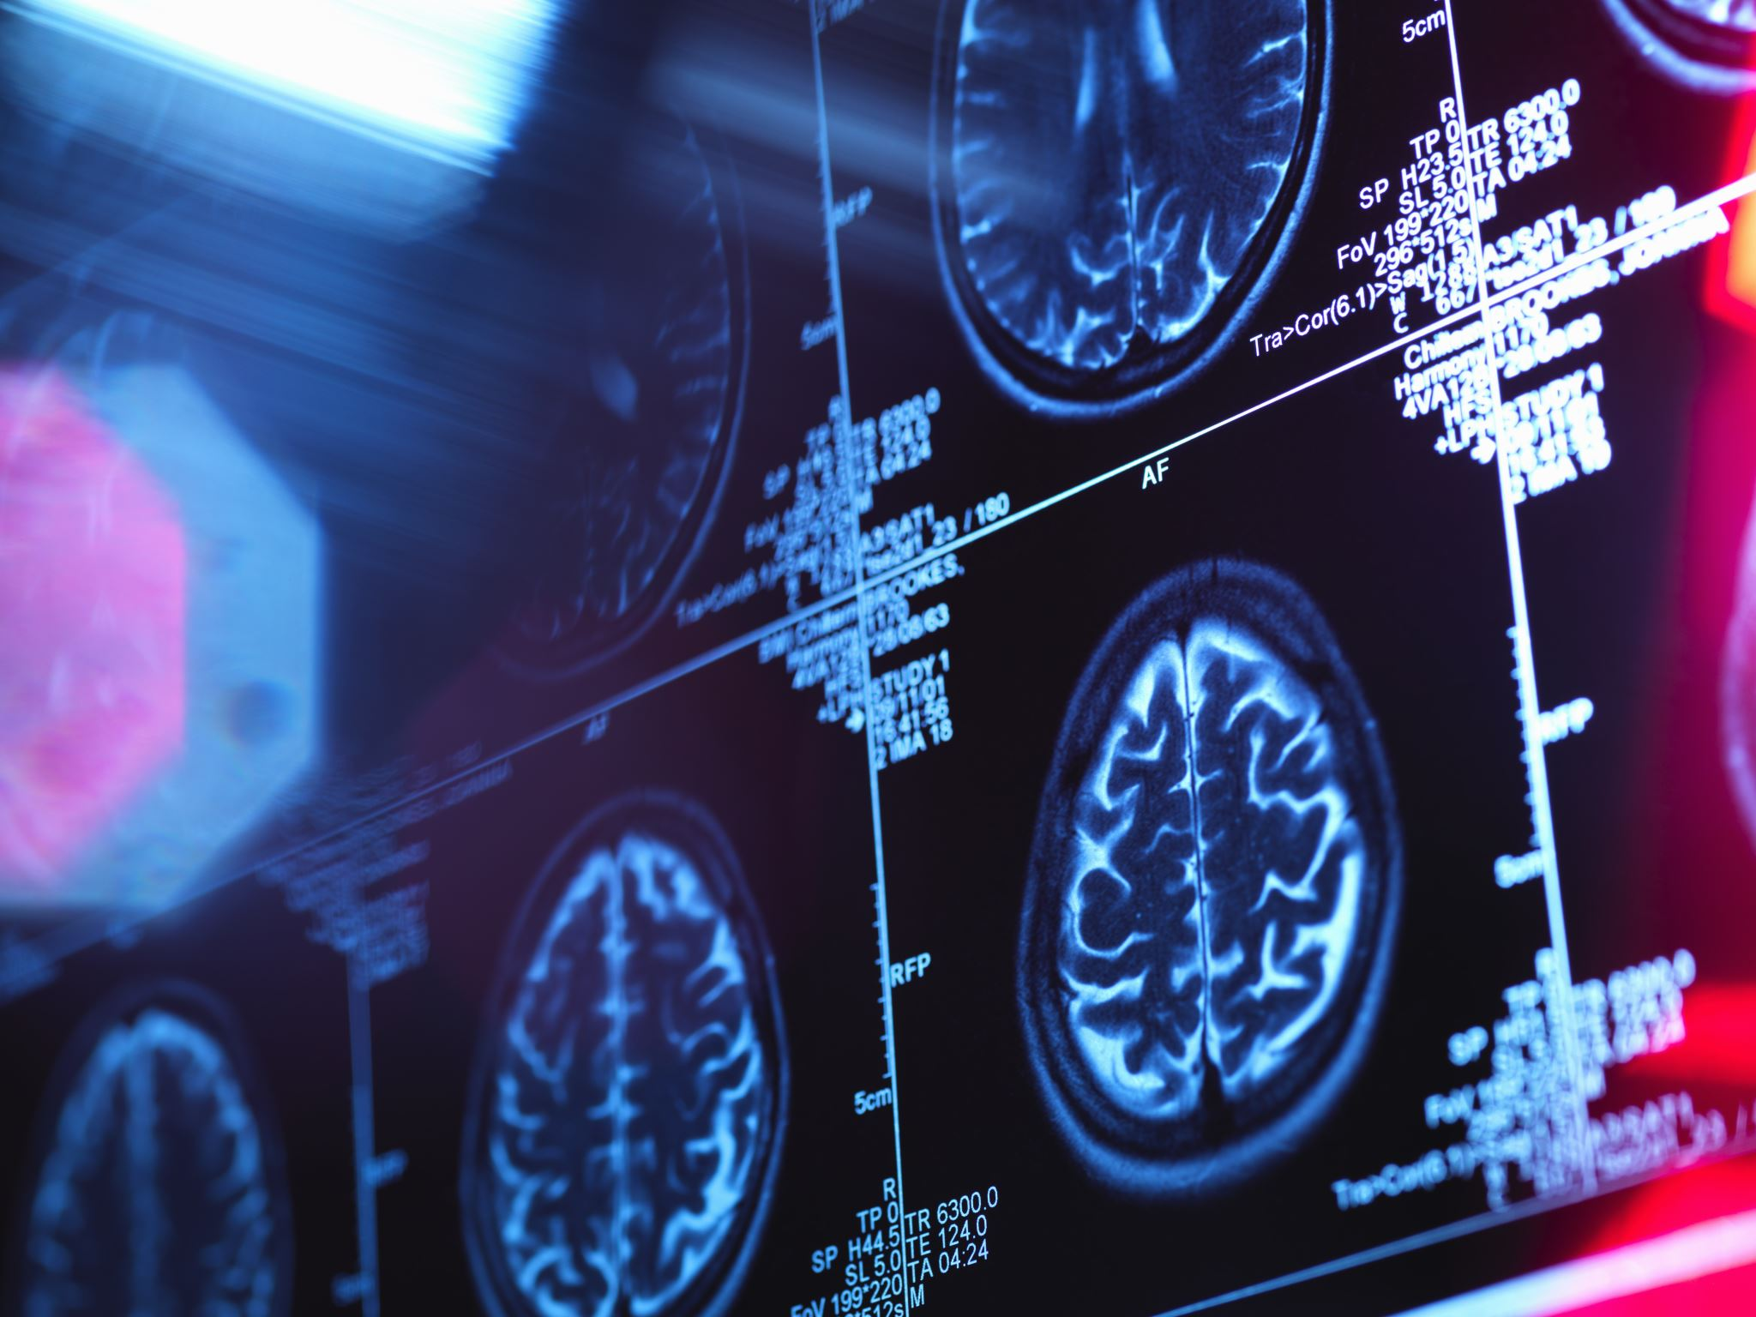
Related Work
Current Diagnostic Techniques: Overview of traditional methods like fundus photography and optical coherence tomography (OCT). Challenges include high costs, need for expert handling, and variability in diagnosis.
Deep Learning in Medical Imaging: Recent advancements in CNNs have shown promising results in medical fields by automating the detection of complex patterns in data.
Transfer Learning in Ophthalmology: Adaptation of models trained on large datasets to specific tasks like ocular disease classification has enhanced model performance and efficiency.
Data Augmentation in Medical Imaging: Techniques to artificially expand training datasets help improve model resilience and address the issue of limited annotated medical images.
Impact of Automated Systems: Previous studies have demonstrated that deep learning can significantly enhance diagnostic accuracy and reduce dependency on specialized knowledge.

Slide 7
Problem Statement
Complex Detection of Ocular Diseases: Ocular diseases often have subtle and inconspicuous manifestations that can remain undetected until advanced stages.
1
Deep Learning in Medical Imaging: Recent advancements in CNNs have shown promising results in medical fields by automating the detection of complex patterns in data.
2
Dependency on Expert Analysis: Diagnosis heavily relies on the expertise of ophthalmologists, creating bottlenecks due to limited availability, especially in less affluent regions.
3
Subjectivity and Inconsistency: Manual diagnosis introduces variability, affecting reliability and precision of the diagnostic outcomes.
4
Technological Barriers: High costs and need for specialized equipment limit the accessibility of advanced diagnostic methods in economically constrained settings.
5

Slide 8
Proposed Solution
Leverage
Advanced Deep Learning Model: Leverage the capabilities of CNNs and transfer learning to develop a robust model for classifying ocular diseases from retinal images.
Adapt
Utilization of Pre-trained Models: Adapt models like VGG16 that have been trained on extensive, general datasets to specific tasks, enhancing accuracy while minimizing resource requirements.
Implement
Robust Data Augmentation: Implement data augmentation strategies to artificially expand the training dataset, enhancing the model's ability to generalize and resist overfitting.
Design
Integration in Clinical Settings: Design the system to be scalable and easily integrated into existing healthcare infrastructure, allowing for early detection and efficient management of ocular diseases.
Conduct
Performance Evaluation: Conduct comprehensive testing and validation against traditional diagnostic methods to demonstrate improvements in accuracy, speed, and reliability.

Slide 9
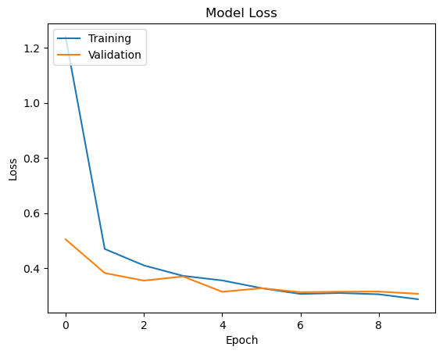
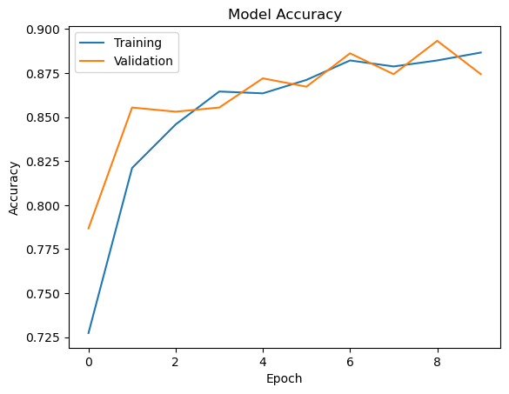
Results/Simulations
Model Performance: The deep learning model achieved an accuracy of 88.67% on the training set and 87.44% on the validation set, indicating strong generalization capabilities.
Comparison with Traditional Methods: Demonstrated superior precision and reliability in detecting ocular diseases compared to conventional diagnostic methods.
Impact of Data Augmentation: Enhanced model resilience against overfitting, with significant improvements in handling diverse and challenging real-world scenarios.
Real-World Application: Preliminary tests in simulated clinical environments showed that the model could effectively integrate with existing medical imaging systems, enhancing diagnostic processes.
Graphical Visualizations: Included are graphs showing training and validation accuracy, loss trends over epochs, and examples of model predictions with confidence levels, illustrating the model's diagnostic accuracy.

Slide 10
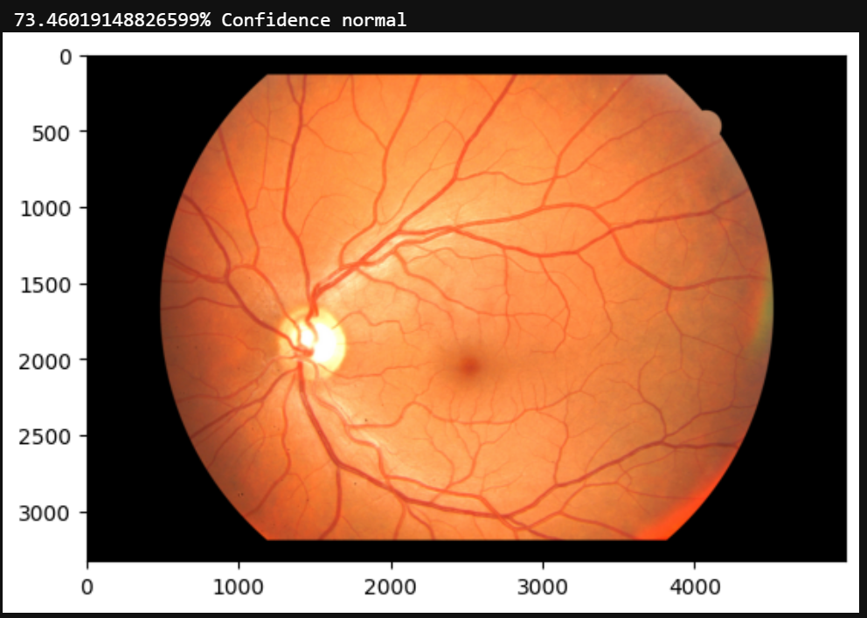
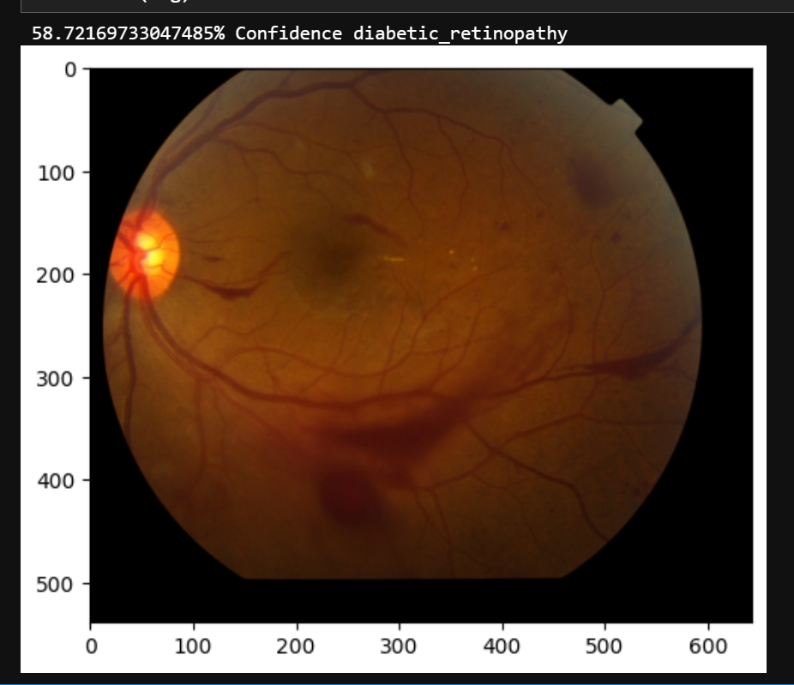
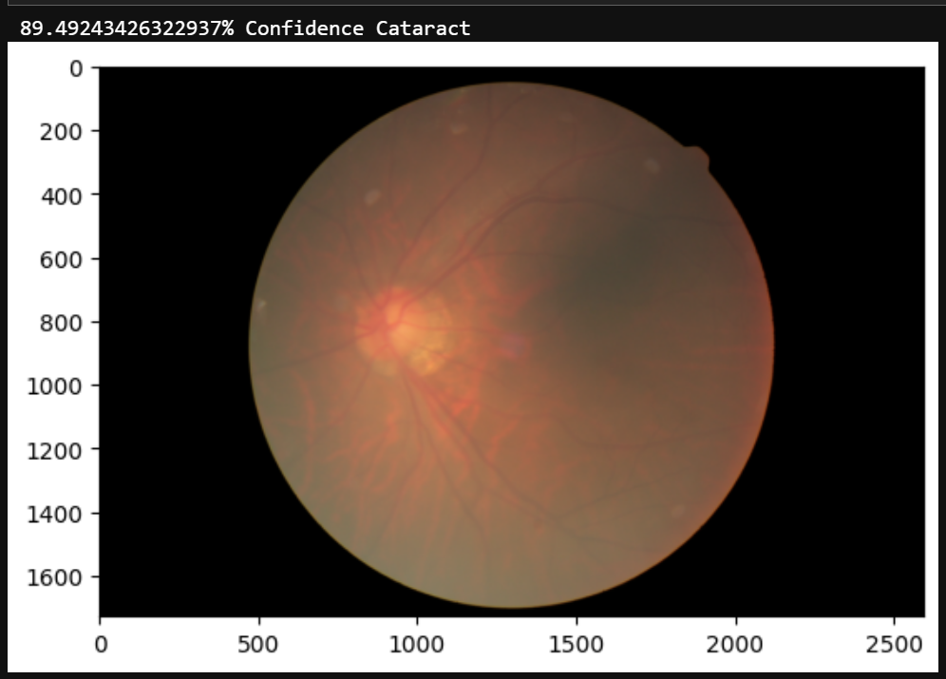
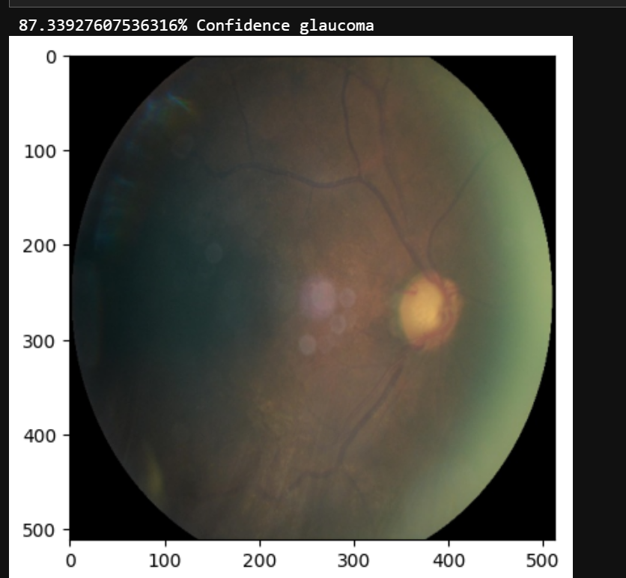
Model Predictions on the Eye Images

Slide 11
References
[1] G. An, M. Akiba, K. Omodaka, T. Nakazawa, and H. Yokota, "Hierarchical deep learning models using transfer learning for disease detection and classification based on a small number of medical images," Scientific Reports, vol. 11, 2021, doi: 10.1038/s41598-021-83503-7.
[2] M. Smaida and S. Yaroshchak, "Using Ensemble Learning for Diagnostics of Eye Diseases," International Journal of Scientific and Research Publications, vol. 10, pp. 273-279, 2020, doi: 10.29322/ijsrp.10.10.2020.p10639.
[3] I. Keerthana and R. Kumar, "A Survey of Deep Learning Models to Detect and Classify Eye Disorders," 2023 International Conference on Sustainable Computing and Smart Systems (ICSCSS), 2023, pp. 30-36, doi: 10.1109/ICSCSS57650.2023.10169846.
[4] N. Chea and Y. Nam, "Classification of Fundus Images Based on Deep Learning for Detecting Eye Diseases," Computers, Materials & Continua, 2021, doi: 10.32604/CMC.2021.013390.
[5] "Eye Disease Classification based on Deep Belief Networks," International Journal of Recent Technology and Engineering, 2019, doi: 10.35940/ijrte.b1552.0982s1119.
[6] T. Babaqi, M. Jaradat, A. Yildirim, S. AL-Nimer, and D. Won, "Eye Disease Classification Using Deep Learning Techniques," ArXiv, abs/2307.10501, 2023, doi: 10.48550/arXiv.2307.10501.
[7] H. Gu et al., "Deep learning for identifying corneal diseases from ocular surface slit-lamp photographs," Scientific Reports, vol. 10, 2020, doi: 10.1038/s41598-020-75027-3.
[8] R. Amin, A. Ahmed, S. Hasan, and H. Akbar, "Multiple eye disease detection using deep learning," Foundation University Journal of Engineering and Applied HEC Recognized Y Category, ISSN 2706-7351, 2023, doi: 10.33897/fujeas.v3i2.689.
[9] M. Khan et al., "Deep Learning for Ocular Disease Recognition: An Inner-Class Balance," Computational Intelligence and Neuroscience, vol. 2022, 2022, doi: 10.1155/2022/5007111.
[10] R. Nejad, J. Khoramdel, A. Ghanbarzadeh, M. Sharbatdar, and E. Najafi, "A Multiclass Retinal Diseases Classification Algorithm using Deep Learning Methods," 2022 10th RSI International Conference on Robotics and Mechatronics (ICRoM), 2022, pp. 365-370, doi: 10.1109/ICRoM57054.2022.10025206.
[11] N. Nivetha, "Retinal-Based Pathology Analysis Using Deep Learning Approaches," vol. 12, pp. 828-840, 2021, doi: 10.17762/TURCOMAT.V12I7.2664.
[12] S. Chelaramani, M. Gupta, V. Agarwal, P. Gupta, and R. Habash, "Multi-task Learning for Fine-Grained Eye Disease Prediction," pp. 734-749, 2019, doi: 10.1007/978-3-030-41299-9_57.
[13] F. Belharar and N. Zrira, "DeepRetino: Ophthalmic Disease Classification from Retinal Images using Deep Learning," 2022 IEEE 9th International Conference on Sciences of Electronics, Technologies of Information and Telecommunications (SETIT), 2022, pp. 392-399, doi: 10.1109/SETIT54465.2022.9875570.
[14] S. Serte, A. Serener, and F. Al-turjman, "Deep learning in medical imaging: A brief review," Transactions on Emerging Telecommunications Technologies, vol. 33, 2020, doi: 10.1002/ett.4080.
[15] A. Miere et al., "Deep Learning-Based Classification of Inherited Retinal Diseases Using Fundus Autofluorescence," Journal of Clinical Medicine, vol. 9, 2020, doi: 10.3390/jcm9103303.
[16] T. Jo, K. Nho, and A. Saykin, "Deep Learning in Alzheimer's Disease: Diagnostic Classification and Prognostic Prediction Using Neuroimaging Data," Frontiers in Aging Neuroscience, vol. 11, 2019, doi: 10.3389/fnagi.2019.00220.
[17] X. Luo, J. Li, M. Chen, X. Yang, and X. Li, "Ophthalmic Disease Detection via Deep Learning With a Novel Mixture Loss Function," IEEE Journal of Biomedical and Health Informatics, vol. 25, pp. 3332-3339, 2021, doi: 10.1109/JBHI.2021.3083605.
[18] C. Guo, M. Yu, and J. Li, "Prediction of Different Eye Diseases Based on Fundus Photography via Deep Transfer Learning," Journal of Clinical Medicine, vol. 10, 2021, doi: 10.3390/jcm10235481.
[19] N. Narayanan, "OPHTHALMIC DISEASE DETECTION USING DEEP LEARNING," International Scientific Journal of Engineering and Management, 2023, doi: 10.55041/isjem01296.
[20] A. Saini, K. Guleria and S. Sharma, "An Efficient Deep Learning Model for Eye Disease Classification," 2023 International Research Conference on Smart Computing and Systems Engineering (SCSE), 2023, pp. 1-6, doi: 10.1109/SCSE59836.2023.10215000.
[21] A. Serener and S. Serte, "Transfer Learning for Early and Advanced Glaucoma Detection with Convolutional Neural Networks," 2019 Medical Technologies Congress (TIPTEKNO), 2019, pp. 1-4, doi: 10.1109/TIPTEKNO.2019.8894965.
[22] R. Sarki, S. Michalska, K. Ahmed, H. Wang, and Y. Zhang, "Convolutional neural networks for mild diabetic retinopathy detection: an experimental study," 2019, doi: 10.1101/763136.
[23] A. Choudhary, S. Ahlawat, S. Urooj, N. Pathak, A. Lay-Ekuakille, and N. Sharma, "A Deep Learning-Based Framework for Retinal Disease Classification," Healthcare (Basel, Switzerland), vol. 11, no. 2, p. 212, 2023, doi: 10.3390/healthcare11020212.

